Slide 1
CS3343 Software Engineering Practise
Group 6
Chan Ho Man 53078369 Chan Ho Man 53091240 Cheung Chi Ngai 53013494 Cheuk Yik Sum 53012319 Lee Man To 53075299 Ho Sui Cheong Johnathan 53117178

Slide 2
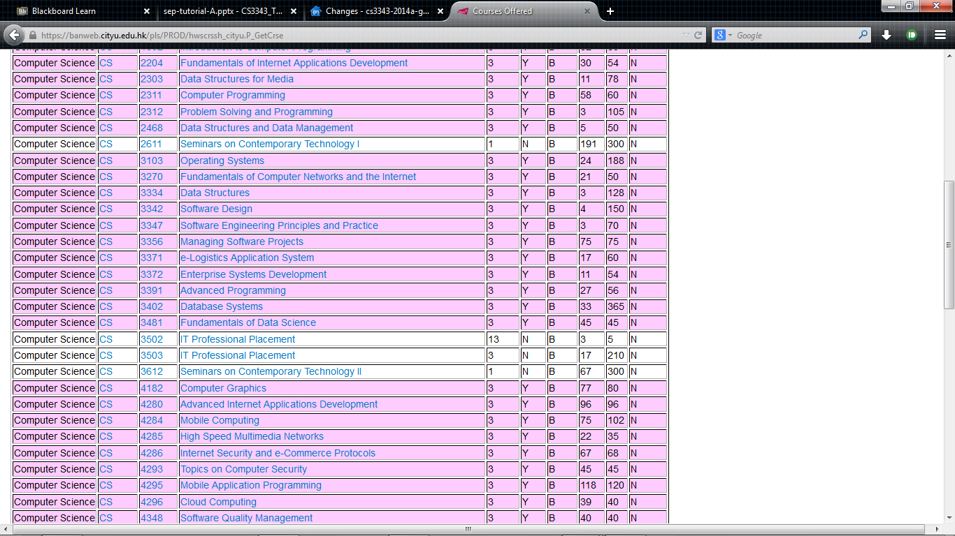
Problem

Slide 3
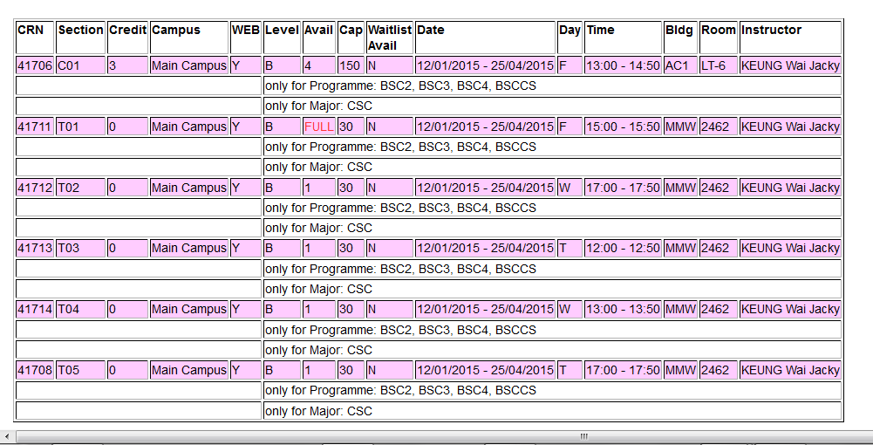
Problem

Slide 4
Class Scheduler - Objective
To help student in registering their desire courses in a easy way
Reduce the time comparing time slots between courses
Give a clear result

Slide 5
Class Scheduler - Achievement
Able to detect and handle conflicts between courses
Able to handle lecture and tutorial section
Able to arrange according to priority
Able core and non-core courses.

Slide 6
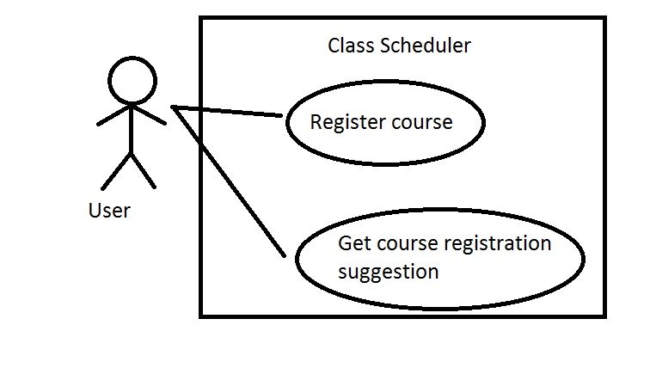
Class Scheduler – Use Case

Slide 7
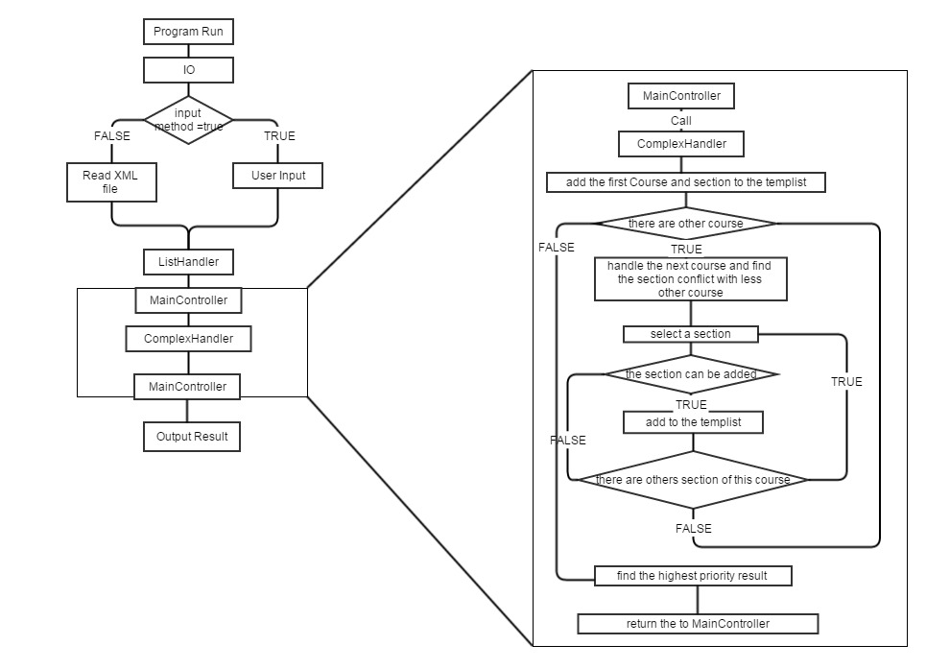
Class Scheduler - Logic

Slide 8
Class Scheduler - Example
Course | Core | Lec | Tut 1 | Tut 2
CS4182 | Yes | Sat 11-13 | Tue 13-15
CS4280 | No | Fri 9-11 | Fri 11-12
CS4284 | No | Sat 11-13 | Mon 15-16
CS4285 | No | Tue 12-13 | Fri 11-12 | Fri 13-14

Slide 9
Course Scheduler
Define problem
Design Solution
Software Development
Software Testing
Deployment
Design Use Case Diagram
Get User Requirement
Decide the implementation of the program
Define set of functions
Define the structure of Program
Release1
Release 2
Release 3
Unit Test
System Test
Release 1
Release 2
Release 3

Slide 10
Course Scheduler
Controllers
Exception Class
IO Module
Store
MainController
IO
XMLparser
Course
Section
ListHandler
OverlapDetector
ConflictDetector
FormatConverter
StoredItem
StoredList
TimeTable

Slide 11
Class Scheduler - Environment
Tool | Usage
Google Code | Repository
TortoiseSVN | Version Control
Eclipse | IDE
JUnit | Testing

Slide 12
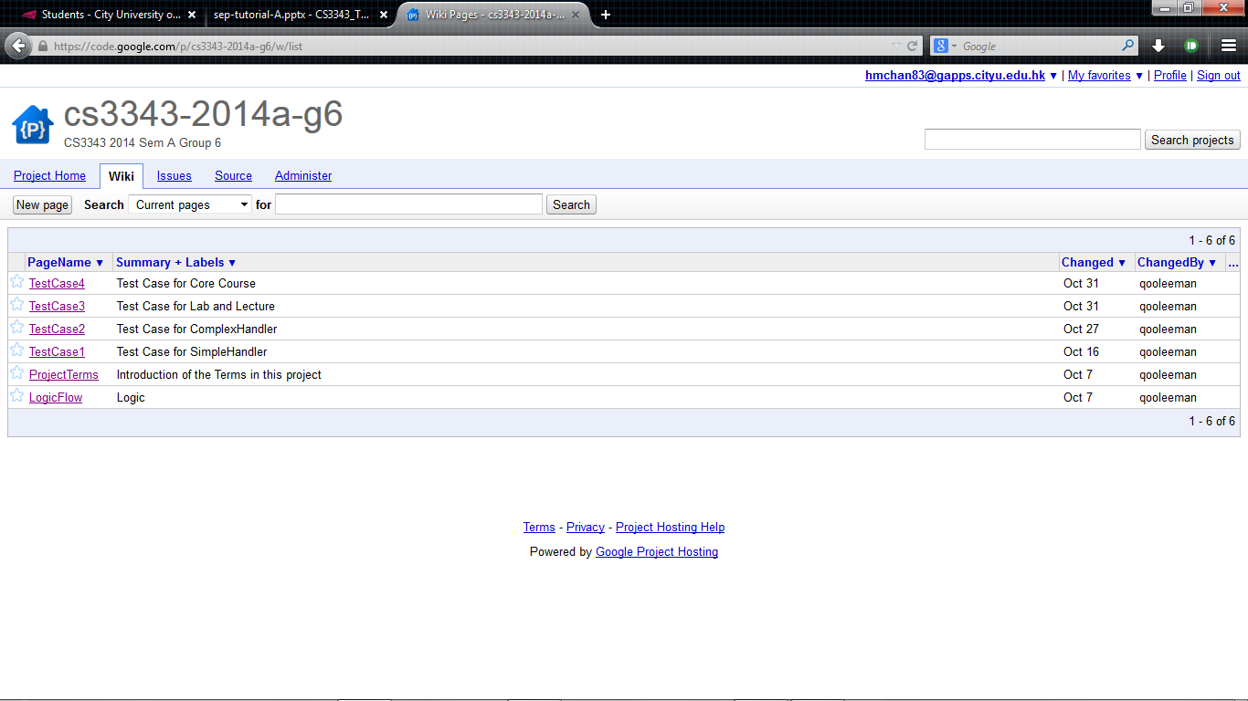
Class Scheduler - Environment

Slide 13
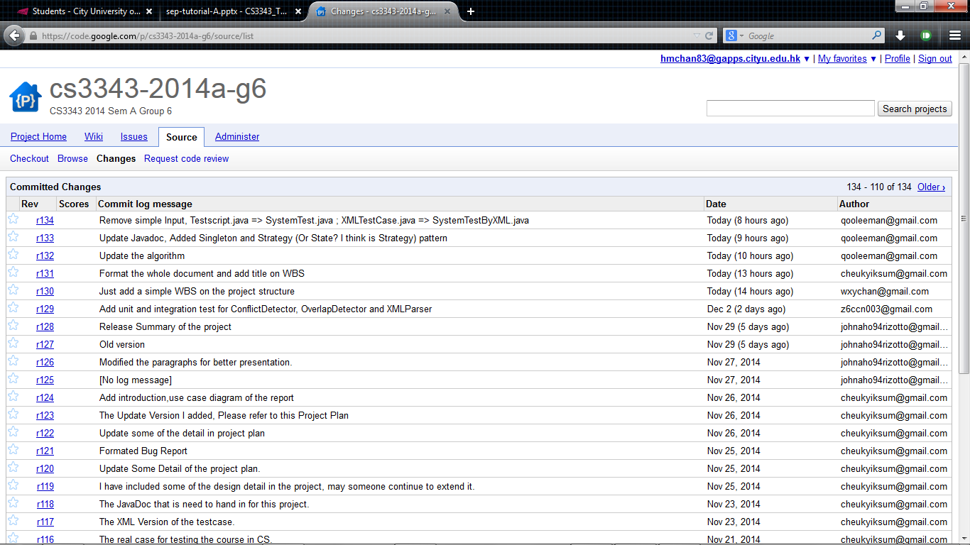
Class Scheduler - Environment

Slide 14
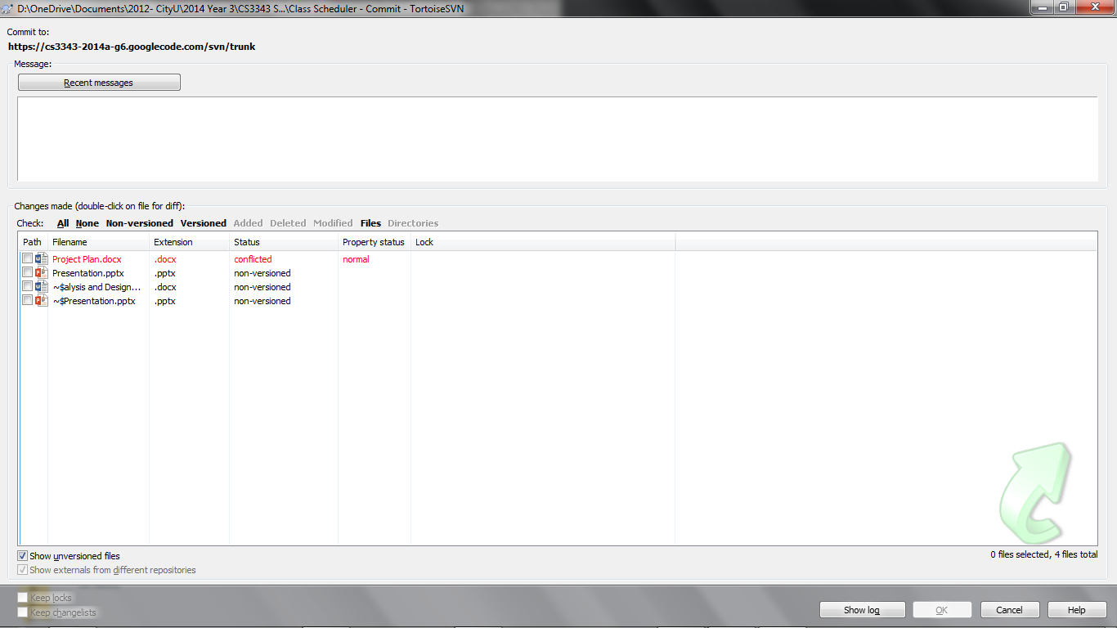
Class Scheduler - Environment

Slide 15
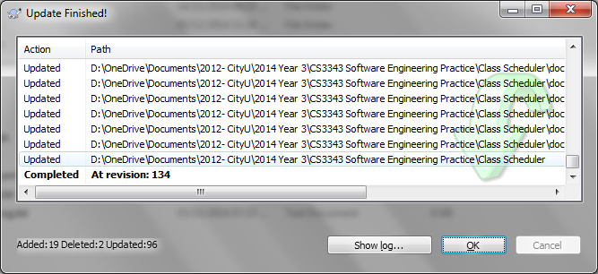
Class Scheduler - Environment

Slide 16
Design Patterns
Pattern | Class
Open Close Principle | Classes in Stored Package
Single Responsibility Principle | Controller classes
Façade Pattern | Controllers
Singleton Pattern | Lab and Lec class

Slide 17
Class Scheduler - Testing
Bottom-Up
Ensure small parts of the system is working
Minimize the use of test stubs

Slide 18
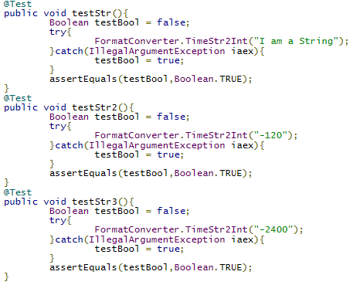
Example of test cases

Slide 19
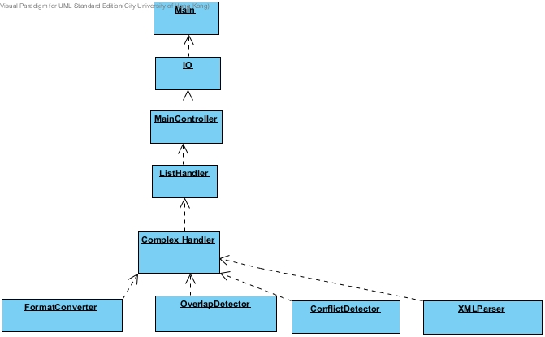
Test structure (bottom-up)

Slide 20
Coverage

Slide 21
Task Distribution
Name | SID | Role
CHAN Ho Man | 53078369 | Project Manager
CHEUK Yik Sum | 53012319 | Assistant Project Manager
CHAN Ho Man | 53091240 | Scrum Master
LEE Man To | 53075299 | Pair Programmer
HO Sui Cheong Jonathan | 53117178 | Pair Programmer
CHEUNG Chi Ngai | 53013494 | Pair Programmer

Slide 22
END

